Slide 1
Energy from a wave
As the wave moves forward, it makes the ball move up and down.
The wave transfers energy to the ball.

Slide 2
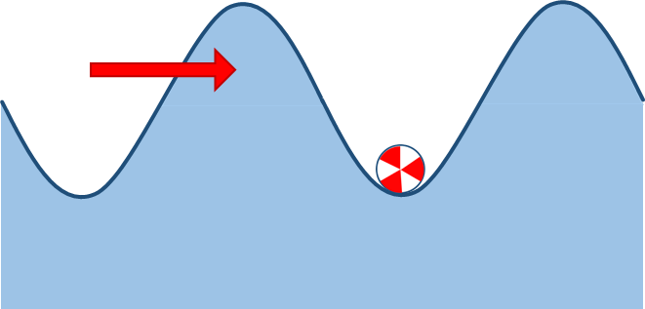
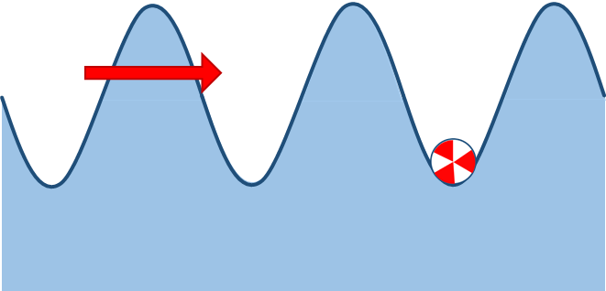
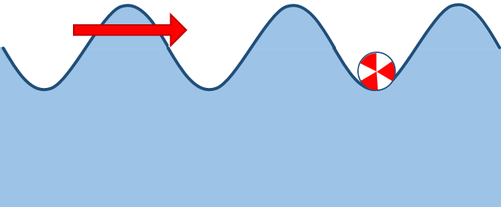
Energy from a wave
a. Which wave transfers energy to the ball most quickly?
A
B
C
D

Slide 3
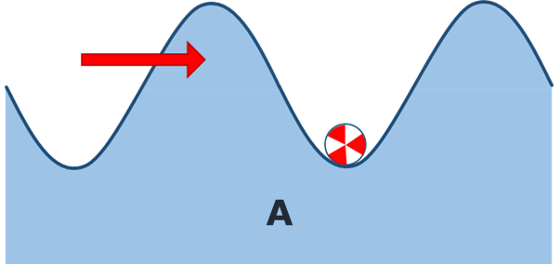
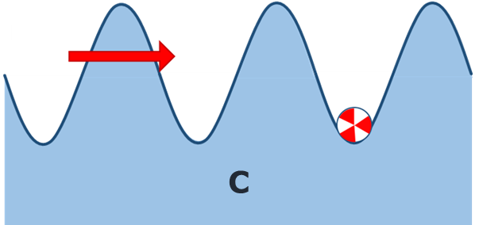
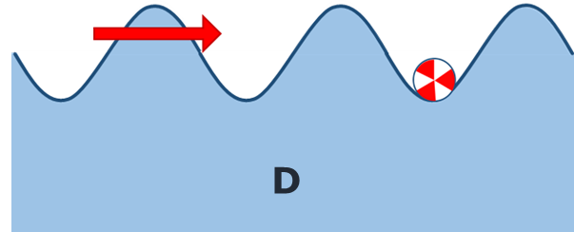
Energy from a wave
b. What is the best reason for your last answer?
A
This wave contains most water.
B
This wave makes the ball move most quickly.
C
This wave contains most energy.
D
This wave hits the ball with most force.

